Slide 1
Paintball Environment Tactical Engagement Recon System (P.E.T.E.R.S.)
Group Number: BCC-4
Richard Taylor – C.E.
Anthony (AJ) Schmidt – E.E.
Kenneth Hale – E.E.
Brett Reich – C.E.
Antonio Foster – E.E.
Advisor
Dr. Christopher Peters – E.C.E.
December, 2015 – Fall Quarter
Notes:
Team Introductions

Slide 2
Presentation Outline
Introduction
Problem Statement
Background Research
Proposed Solution
Fall Progress
Winter Progress
Work Schedule / Timeline
Team Member Responsibility
Budget
Potential Societal Impacts
Summary
References
Notes:
Antonio

Slide 3
Introduction
In the game of paintball, there are a lot of distractions that prevent players from coordinating with teammates as efficiently as possible.
Distractions Include
Determining Team Location
Paintball Availability
Air Pressure Availability
This project aims to provide a solution for the most common and most frequent issues that players face on the field.
Notes:
Antonio

Slide 4
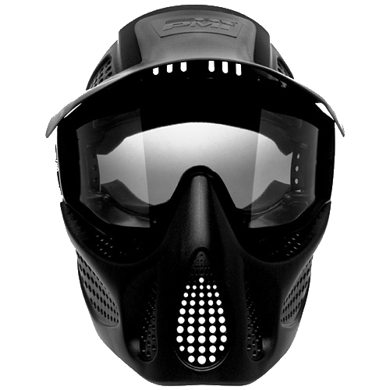
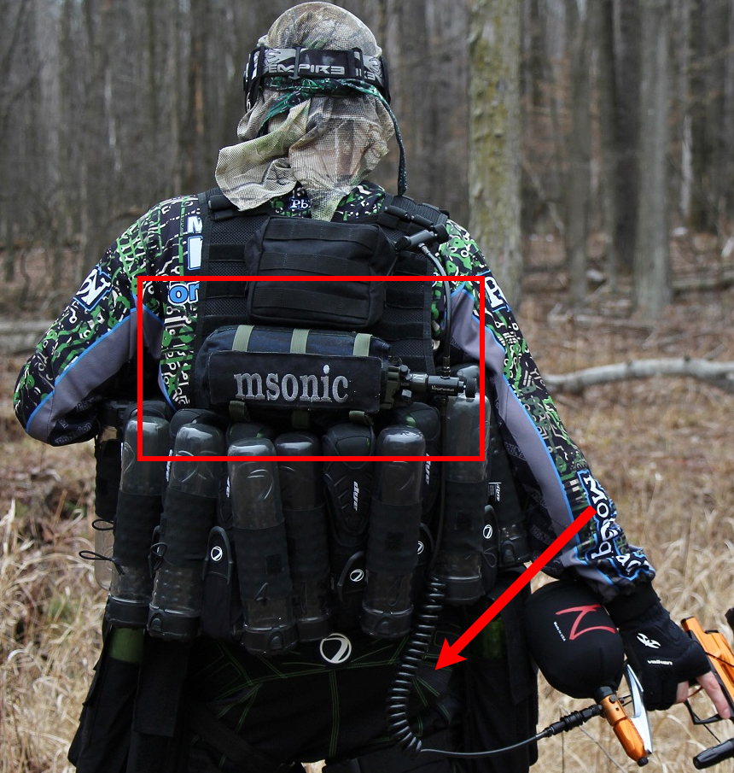
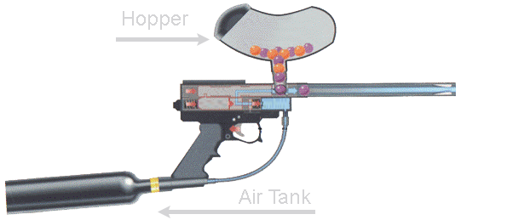
Introduction - Equipment Overview
Notes:
Antonio

Slide 5
Problem Statement
Our research indicates that there is currently no single product available that addresses all of the most common distractions that a player faces while playing the game of paintball.
We plan to utilize various sensors, a display, and a communication network to develop a single system which alleviates these distractions.
Notes:
Rick

Slide 6
Background Research - Requirements
In order to design a system that addresses the previously mentioned problem statement, the following requirements were derived:
The system shall:
Collect real-time data on user provisions (paint and pressure levels)
Track user location
Process data to be displayed to the user
Share user location with teammates
Display information on user provisions, user location, and teammate location
Notes:
Rick derived not designed

Slide 7
Background Research - Standards
Standard ECMA-404 (JSON Data Interchange Format)
Standard IEEE 802.11 – Wi-Fi
Standard IEEE 802.15 - Bluetooth
EPA regulation 40 CFR 273.13(a) (Waste management requirements for small quantity handlers of universal waste batteries)
Notes:
"Listed here are a few standards that were considered as applicable to the PETERS project. This Includes standard ECMA-404.(JSON data interchange), This is how we communicate to and from our Raspberry Pi and its peripherals.
Then there are IEEE 802.11 and 802.15 which cover Wi-fi and Bluetooth respectively. However because we are only using off the shelf wireless devices, these standards are already satisfied.
Because The Snow2 uses a lithium Ion battery, another applicable standard is EPA regulation 40 CFR 273.13(a). This standard talks about the proper handling of batteries and how they must be sealed and non-leaking at all times.
Ken

Slide 8
Proposed Solution
A system consisting of the following:
Honeywell Pressure Sensor mounted to air tank regulator
Collects real time data on available pressure in tank
Hopper with Ultrasonic Sensor System
Monitors available paint levels in hopper
Arduino Pro Mini’s with Xbee Dongles
Wirelessly transmit data from sensors to server
Raspberry Pi 2 with Wi-Fi/Xbee Dongles
Processes data
Share data between users
Recon Snow2 Heads Up Display (HUD)
Displays Information to the user
Notes:
Basically read slide
AJ

Slide 9
Proposed Solution – HUD GUI
Notes:
Rick

Slide 10
Proposed Solution – Block Diagram
Notes:
This slide shows the basic overview of how our system will work. Solid lines indicate wired connections, while dashed lines indicate wireless communications. In the top left you’ll see the pressure sensor. The pressure sensor is hardwired directly to the Raspberry Pi which is the central point for data processing and communications. Below the pressure sensor in the bottom left is the break-beam sensor circuitry. This will also be hardwired to the Raspberry Pi but has an optional wireless connection in which sensor data can be sent to the Raspberry Pi wirelessly by an Arduino board. In the top right, you’ll see the Snow2 HUD. This Snow2 HUD will communicate with the Raspberry Pi wirelessly and bi-directionally. It will receive visual information such as maps and alerts from the Pi and will transmit GPS information back to the Pi.
AJ

Slide 11
Proposed Solution – Feasibility
Use of commercial-off-the-shelf products (C.O.T.S.) helps to satisfy our requirements
Pressure Sensor found that fits the requirements
Recon Snow2 has built-in GPS module, and many other features
Raspberry Pi 2 satisfies the processing requirement
By compartmentalizing the project into smaller tasks, the overall project becomes more manageable
Notes:
Antonio

Slide 12
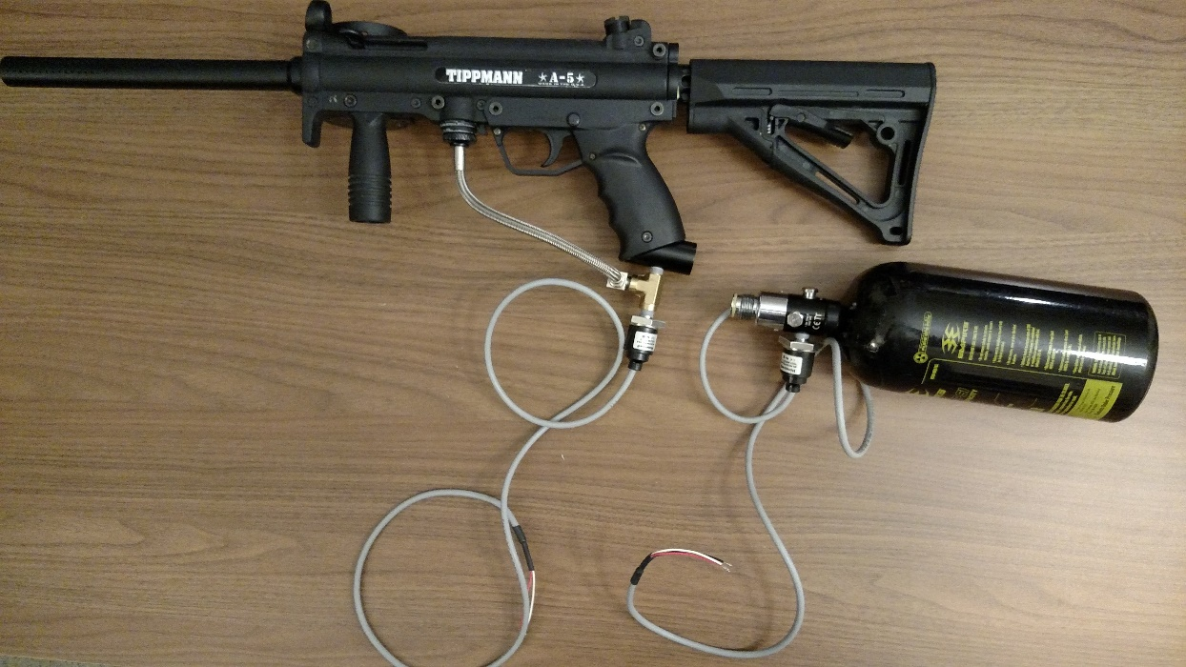
Fall Progress – Hardware
All equipment purchased and acquired
Honeywell Pressure sensor mounted and tested in 2 locations
Gathered important data using Arduino
Preliminary Break Beam Feasibility Test Completed
A
B
A – Pressure Sensor Mounted on Marker
B – Pressure Sensor Mounted on Tank
Notes:
Antonio

Slide 13
Fall Progress - Software
Base classes for GUI display framework
Moving Map Overlay
Utility classes (i.e. Latitude/Longitude to Pixel Position)
Supplemental classes (i.e. overlay constructors, icons, alert formatting, etc.)
Air Tank Readout and Paint Level Overlay
Python Application Packaging for Android
Basic network framework
Communication of JSON formatted messages
Data Collecting Utility
Gathered important data from Pressure Sensor
Paint detection algorithm
Notes:
Brett / Rick

Slide 14
Winter Progress - Hardware
Hopper Mount Designed & 3d Printed
Arduino Pro Mini – Microcontroller to collect data from sensors
Ultrasonic Sensor – Measure paint levels
Xbee – Wireless serial bridge
Accelerometer – Measure angle of hopper
Battery – Removable, rechargeable 5v
Pressure Sensor Mount Design & Ready to Print
Arduino Pro Mini – Microcontroller to collect data from sensors
Honeywell Pressure Sensor – Measure pressure levels
Xbee – Wireless serial bridge
Battery – Removable, rechargeable 5v

Slide 15
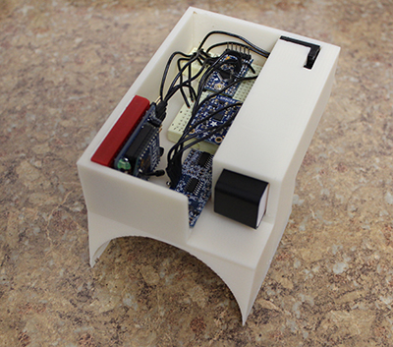
Winter Progress - Hardware

Slide 16
Winter Progress - Software
Sensor Collection & Server

Slide 17
Winter Progress - Software
GUI

Slide 18
Work Schedule / Timeline
Notes:
Rick

Slide 19
Team Member Responsibility
Team Member | Completed | In Progress | Future
Richard Taylor | Graphical Display Framework Assisted with Wireless Data Transfer Framework | Application Packaging for HUD Implementing Moving Map Subpanel | Further GUI Subpanel Implementation
Brett Reich | Threaded Network Sockets JSON Message Passing Shared Message Server | Application Packaging for HUD Map Data URL Generation Map Data Downloading | Map Data Storage Sensor Data Storage Automatic Unit Detection
Kenneth Hale | Sensor Research Sensor Test and Evaluation Data Collection Methods | Software Development Ramp-up Assist in Break Beam System Development | Assist in GUI Development Product Packaging Break Beam Software Development
Anthony (AJ) Schmidt | Sensor Research Sensor Test and Evaluation Data Collection Methods | Break Beam Hardware Development Hopper Design | Hopper Construction Product Packaging Mask Modification
Antonio Foster | Sensor Research Sensor Test and Evaluation Data Collection Methods | Break Beam Hardware Development Hopper Design | Break Beam Software Development Product Packaging Mask Modification
Notes:
Group Talk
Brett needs to fill in his.

Slide 20
Budget - Industrial
Planned Expenses | Jan | Feb | Mar | Apr | May | Jun | Jul | Aug | Sep | Oct | Nov | Dec | YEAR
Employee Costs | Jan | Feb | Mar | Apr | May | Jun | Jul | Aug | Sep | Oct | Nov | Dec | YEAR
Wages | $25,000.00 | $25,000.00 | $25,000.00 | $25,000.00 | $25,000.00 | $25,000.00 | $25,000.00 | $25,000.00 | $25,000.00 | $25,000.00 | $25,000.00 | $25,000.00 | $300,000.00
Benefits | $6,750.00 | $6,750.00 | $6,750.00 | $6,750.00 | $6,750.00 | $6,750.00 | $6,750.00 | $6,750.00 | $6,750.00 | $6,750.00 | $6,750.00 | $6,750.00 | $81,000.00
Subtotal | $31,750.00 | $31,750.00 | $31,750.00 | $31,750.00 | $31,750.00 | $31,750.00 | $31,750.00 | $31,750.00 | $31,750.00 | $31,750.00 | $31,750.00 | $31,750.00 | $381,000.00
Office Costs | Jan | Feb | Mar | Apr | May | Jun | Jul | Aug | Sep | Oct | Nov | Dec | YEAR
Office lease | $1,720.00 | $1,720.00 | $1,720.00 | $1,720.00 | $1,720.00 | $1,720.00 | $1,720.00 | $1,720.00 | $1,720.00 | $1,720.00 | $1,720.00 | $1,720.00 | $20,640.00
Gas | $200.00 | $200.00 | $200.00 | $50.00 | $50.00 | $50.00 | $50.00 | $50.00 | $50.00 | $50.00 | $200.00 | $200.00 | $1,350.00
Electric | $80.00 | $80.00 | $80.00 | $150.00 | $150.00 | $150.00 | $150.00 | $150.00 | $150.00 | $150.00 | $80.00 | $80.00 | $1,450.00
Water | $25.00 | $25.00 | $25.00 | $25.00 | $25.00 | $25.00 | $25.00 | $25.00 | $25.00 | $25.00 | $25.00 | $25.00 | $300.00
Telephone | $25.00 | $25.00 | $25.00 | $25.00 | $25.00 | $25.00 | $25.00 | $25.00 | $25.00 | $25.00 | $25.00 | $25.00 | $300.00
Internet access | $75.00 | $75.00 | $75.00 | $75.00 | $75.00 | $75.00 | $75.00 | $75.00 | $75.00 | $75.00 | $75.00 | $75.00 | $900.00
Office supplies | $40.00 | $40.00 | $40.00 | $40.00 | $40.00 | $40.00 | $40.00 | $40.00 | $40.00 | $40.00 | $40.00 | $40.00 | $480.00
Subtotal | $2,165.00 | $2,165.00 | $2,165.00 | $2,085.00 | $2,085.00 | $2,085.00 | $2,085.00 | $2,085.00 | $2,085.00 | $2,085.00 | $2,165.00 | $2,165.00 | $25,420.00
Unit Component Cost | Jan | Feb | Mar | Apr | May | Jun | Jul | Aug | Sep | Oct | Nov | Dec | YEAR
(2) Micro-Bluetooth 4.0 LE | $17.98 |  |  |  |  |  |  |  |  |  |  |  | $17.98
(2) Micro-SD 16GB (Sony 70Mbps) | $17.98 |  |  |  |  |  |  |  |  |  |  |  | $17.98
(2) CanaKit Raspberry Pi-2 + Case | $93.98 |  |  |  |  |  |  |  |  |  |  |  | $93.98
(2) Reacon Snow2 (HUD) | $798.00 |  |  |  |  |  |  |  |  |  |  |  | $798.00
Reacon Snow2 (HUD + Goggles) | $549.00 |  |  |  |  |  |  |  |  |  |  |  | $549.00
(2) MLH05KPSL06A Pressure Sensor | $292.28 |  |  |  |  |  |  |  |  |  |  |  | $292.28
(2) Edimax EW-781Un Wi-Fi Adapter | $19.98 |  |  |  |  |  |  |  |  |  |  |  | $19.98
(2) AA Battery Pack | $38.98 |  |  |  |  |  |  |  |  |  |  |  | $38.98
Laser Diodes 5-pack | $11.89 |  |  |  |  |  |  |  |  |  |  |  | $11.89
Photo-Resistors 20-pack | $4.69 |  |  |  |  |  |  |  |  |  |  |  | $4.69
Misc Materials | $83.11 |  |  |  |  |  |  |  |  |  |  |  | $83.11
Subtotal | $1,927.87 | $0.00 | $0.00 | $0.00 | $0.00 | $0.00 | $0.00 | $0.00 | $0.00 | $0.00 | $0.00 | $0.00 | $1,927.87
TOTALS
Monthly Planned Expenses | $35,842.87 | $33,915.00 | $33,915.00 | $33,835.00 | $33,835.00 | $33,835.00 | $33,835.00 | $33,835.00 | $33,835.00 | $33,835.00 | $33,915.00 | $33,915.00 | $408,347.87
TOTAL Planned Expenses | $35,842.87 | $69,757.87 | $103,672.87 | $137,507.87 | $171,342.87 | $205,177.87 | $239,012.87 | $272,847.87 | $306,682.87 | $340,517.87 | $374,432.87 | $408,347.87
Total - $408,347.87
Notes:
Antonio

Slide 21
Budget – Out of Pocket
Model Name | Unit Cost | Units | Sub-total
AA Battery Pack | $19.49 | 2 | $38.98
Micro-Bluetooth 4.0 LE | $8.99 | 2 | $17.98
Micro-SD 16GB (Sony 70Mb/s) | $8.99 | 2 | $17.98
CanaKit Raspberry Pi 2 + case | $46.99 | 2 | $93.98
SNOW2 (HUD only) | $399.00 | 2 | $798.00
MLH05KPSL06A – Pressure Sensor | $146.14 | 2 | $292.28
Photo-Resistor (20pcs) | $4.69 | 1 | $4.69
SNOW2 (HUD + Goggles) | $549.00 | 1 | $549.00
Laser Diode (5 pcs) | $3.54 | 1 | $3.54
Edimax EW-7811Un Wi-Fi Adapter | $9.99 | 2 | $19.98
Female / Male / Male 1/8th | $36.47 | 1 | $36.47
Shipping (for goggles) | $54.99 | 1 | $54.99
Arduino Pro Mini | $20.00 | 2 | $40.00
Adafruit 9-DOF LSM9DS0 | $20.49 | 1 | $20.49
 |  | Total | $1,988.36
 |  | Per Person | $397.67
Notes:
This is how much we’ve spent on the project so far. Our total cost comes to about $1900 total with each person spending around $385. The most expensive items were the Snow2 HUD and the pressure sensors.
AJ

Slide 22

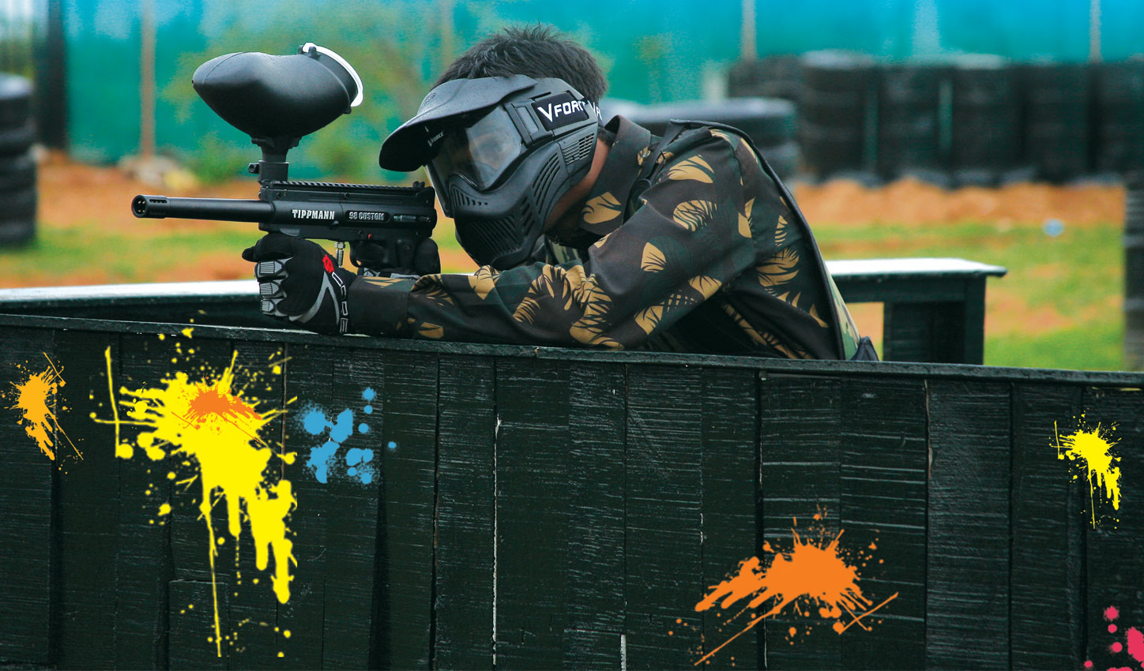
Potential Societal Impacts
Targets existing players and large gaming community
Potential to get thousands of people out of the house and be more active
Possible Integration into Civil Service/Military Applications
Notes:
"Project PETERS is currently targeted at all paintball players and the existing large gaming community. We hope that by changing the dynamic of the game it will relate more with this community and encourage people to become more active. There is also the obvious possibility for future civil and military applications. For example, with some tweaks to the system, project PETERS could be suitable for EMTs, fire fighters, or the police. These are all jobs where knowing the location of your team can be a life and death situation"
Ken

Slide 23
Summary
Important technological change to a popular game
Eliminate common game distractions
Enable players to utilize pertinent data
A lot of work to be done, but a lot had been accomplished
External sensors tested and mounted
Initial Laser Diode testing for low paint count
Networking Software framework developed
Display Software framework developed
Notes:
To summarize, Project PETER’s is about making an important technological change to a popular game.
This change will eliminate common game distractions by providing the user with important real time data.
Although more work needs to be done a lot has been accomplished in the first quarter.
The most notable hardware steps include the Pressure sensor being mounted and tested, and initial testing of a break-beam system for a low paint count.
On the software side, the Networking software framework and the Display software framework both have been developed and tested.
We feel were are on track to complete project PETER’s by the end of March.
Ken

Slide 24
References
Various, "gmapcatcher," Independent, 2010. [Online]. Available: https://code.google.com/p/gmapcatcher/. [Accessed 1 October 2015].
A. K. Goroch, "Algorithms for Converting Geodetic Earth Location to Satellite Time and Swath Pixel Coordinates for the DMSP Satellite System," Naval Oceanographic and Atmospheric Research Laboratory, Monteray, 1991.
Kivy Community Project, "Kivy Framework Reference," 2010. [Online]. Available: http://kivy.org/docs/api-kivy.html. [Accessed October 2015].
Kivy Community Project, "Kivy Introduction," 2010. [Online]. Available: http://kivy.org/docs/gettingstarted/intro.html. [Accessed October 2015].
A. Taylor, "python-for-android Quickstart," Kivy, 2015. [Online]. Available: http://python-for-android.readthedocs.org/en/latest/quickstart/#the-android-ndk-version. [Accessed October 2015].
B. Stimac, "How To Sideload an App Onto Your Android Phone or Tablet," 17 July 2014. [Online]. Available: http://www.greenbot.com/article/2452614/how-to-sideload-an-app-onto-your-android-phone-or-tablet.html. [Accessed October 2015].

Slide 25
Questions
?
Notes:
Possible Questions-
Does the project really warrant 5 team members?
Answer: no, uh i mean, Rick does war stuffs.
Are you on schedule with meeting your goals and completing the project?
Answer: Yes, currently were on pace to finish the project by XXXX
Is this project really worthwhile?
Answer: Yes!, paintball is a billion dollar a year market with technological change in the past 30 or so years.
Our PETERS project would give the game a nice update.
Do you think the GPS utilized will be accurate enough?
Answer: Yes, the GPS system equipped on the Recon Snow 2 is top of the line, and for the purposes of this project
this level of accuracy is suitable.
What if an EMP.....
Answer: Beyond the scope of our project.

Slide 26
Challenges Found
Hardware
Acquiring pressure sensor data that satisfied the real-time requirement
Acquiring a viable solution to paint level indication
Software
Different map projection types creates multiple problem sets in terms of determining player position on the map
Kivy’s Buildozer APK-build tool setup
General
Project Logistics
Notes:
Hardware -Acquiring suitable pressure sensor data (fixed by changing pressure sensor location)
Hardware -Obtaining viable solution to low paint count (fixed by doing lots of research on all possible ways, and choosing laser diodes)
AJ - Height (Still growing?) -

Slide 27
Work Schedule / Timeline
Notes:
Included to show a more detailed timeline of the work to be done.

Slide 28
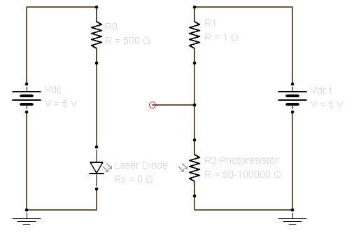
Hopper Mount Circuit
Notes:
Included to show a more detailed timeline of the work to be done.

Slide 29
PSI Tank Circuit

Slide 30
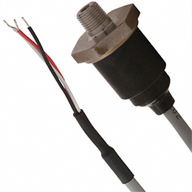
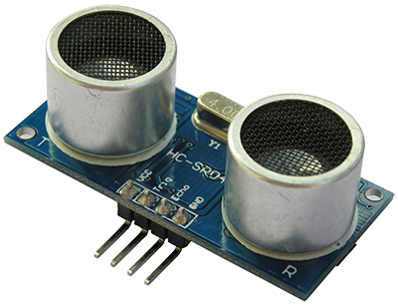
Background Research Requirement - Collecting Data On User Provisions
Air Pressure Levels Existing Solution - Analog Gauge Chosen Solution - Retrofit Pressure Sensor Honeywell MLH06KPSB10A Operating Pressure: 0 – 6000 psi Operating Supply Voltage: 5V | Paintball Levels Existing Solution – Visual Inspection, Clear Hopper Considered Solution – Break Beam Level Indicator Chosen Solution – Ultrasonic Sensor
Notes:
The first requirement that was researched was how to collect data on user provisions. This includes information about air pressure levels and paintball levels. For air pressure, there is only one existing solution; an analog gauge on the air tank itself. This causes the players attention to divert from the game and compromises their tactical advantage. Our solution to eliminate this distraction is to replace the analog gauge with a pressure sensor. The sensor we chose was made by Honeywell and meets our required specifications. It will allow us to monitor the real-time pressure inside the air tank and manipulate that data as we need to. Switching to paintball levels. There is currently two ways that players might check their paint levels. The first is through visual inspection. Like the analog gauge mentioned before, this isn’t ideal because it requires that the player divert their attention from the game. The other option is a clear hopper. The clear hopper isn’t very popular among players because it increases player detectability which compromises tactical advantage. One of the solutions we considered for monitoring paint levels was to specify the hopper’s paint capacity before the game, and subtract the number of paintballs expelled from the marker. The issue with this is that players often refill their hoppers during a game and there is no way for the system to measure how much paint is being loaded back into the hopper. The final solution chosen was to implement a break beam level indicator. This entails constructing a circuit of laser diodes and photo resistors inside the hopper that can detect obstructions and allow us to deduce the estimated paint levels.
AJ
AJ
In order to satisfy the system requirements, research was completed to identify existing solutions to functions the system will carry out.
or
Research was completed to identify existing solutions that satisfy the individual system requirements.
Insert picture of sensor and break beam diagram

Slide 31
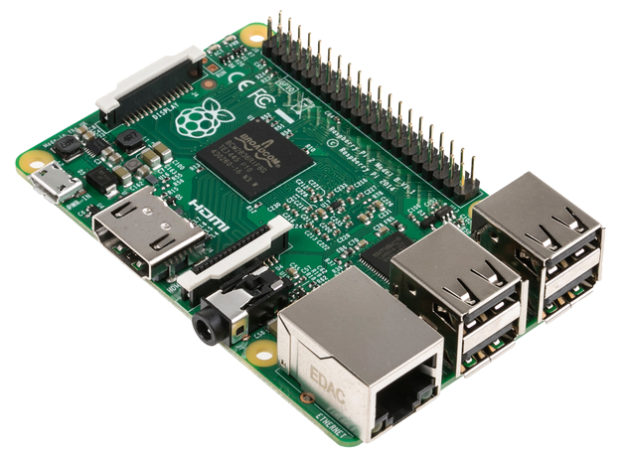
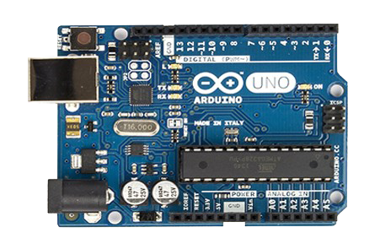


Background Research Requirement - Processing Data to be Displayed to User
Raspberry Pi 2
Arduino Uno
Python Language - Balance of flexibility, performance, and portability
Kivy – Community driven python GUI design tools that translate well to Android systems
Notes:
Brett

Slide 32



Background Research Requirement - Sharing User Location with Teammates
Wi-Fi
Bluetooth
ZigBee
Ranking: (Best) 1 - Worst (4) | Architecture | Range Capability | Link Speed | Integration Complexity | Cost
WiFi | Central | 2 | 1 | 1 | 4
Bluetooth | P2P | 4 | 3 | 2 | 9
Zigbee | Mesh | 3 | 4 | 3 | 10
CDMA/4G | Central | 1 | 2 | 4 | 7
Notes:
Brett
Decision matrix

Slide 33
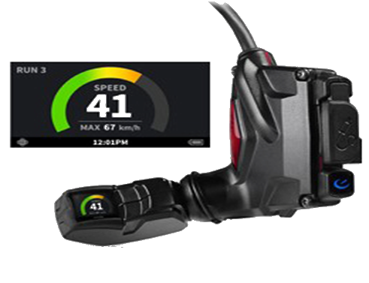
Background Research Requirement - Display Information on User Provisions, User Location, and Teammate Location Requirement - Track User Location
Recon Snow2 HUD
 | Price | Viewing Angle | Resolution | Screen Size | Built-in Sensors | Support | Modularity | Connectivity | Cost
Google Glass | 3 | 2 | 1 | 1 | 2 | 3 | 2 | 1 | 15
GlassUp | 1 | 3 | 3 | 3 | 3 | 2 | 3 | 2 | 20
Recon Snow2 | 2 | 1 | 2 | 2 | 1 | 1 | 1 | 1 | 11
Notes:
"In order to display information to the user we needed to find or build a device that would be a good fit for our application. The team ruled out building our own device due to time constraints. After deciding to use a product off the shelf we narrowed it down to three possibilities including Google Glass, GlassUp and the Recon Snow2. We then ranked these products by the following criteria. Price, viewing angle, resolution, screen-size, built in sensors, support, modularity, and connectivity. With a "1" being the best and a "3" being the worst each product was scored relative to one another. In the end, the Recon Snow2 out-scored the competition by a wide margin. Therefore we chose the Recon Snow2 to display information to the user because it best fits our application.”
Ken

